Slide 1

Disassembling Jack’s Car Rental Problem

Slide 2
Table of Contents
Problem Key Points
Code – Poisson RV Cache
Code – Expected Return
Code – Policy Evaluation
Code – Policy Improvement
Run – Value/Policy Changes
Policy Result

Slide 3
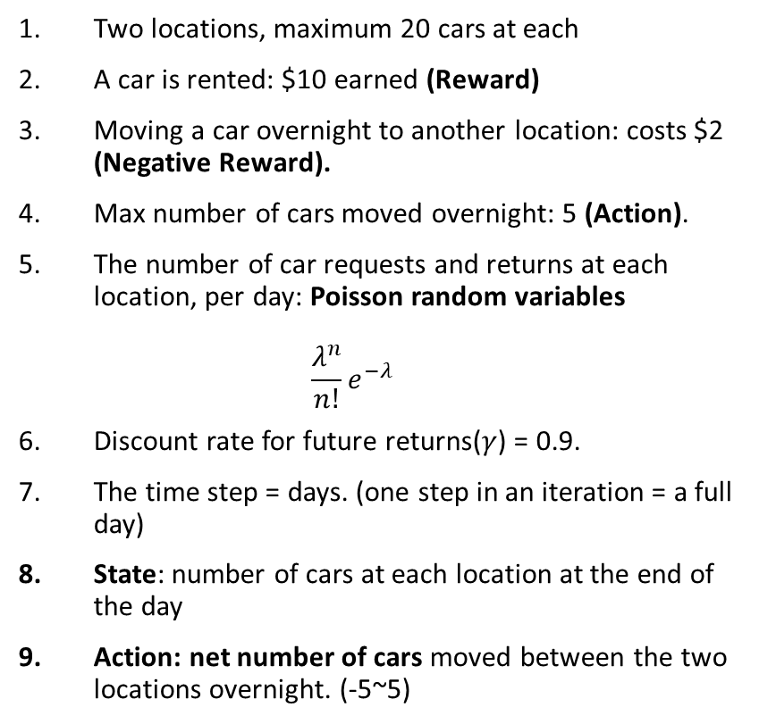
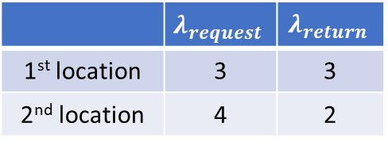
1. Problem Key Points
 | $$λ_{request}$$ | $$λ_{return}$$
1st location | 3 | 3
2nd location | 4 | 2
Two locations, maximum 20 cars at each
A car is rented: $10 earned (Reward)
Moving a car overnight to another location: costs $2 (Negative Reward).
Max number of cars moved overnight: 5 (Action).
The number of car requests and returns at each location, per day: Poisson random variables $\frac{λ^{n}}{n!}e^{−λ}$
Discount rate for future returns($γ$) = 0.9.
The time step = days. (one step in an iteration = a full day)
State: number of cars at each location at the end of the day
Action: net number of cars moved between the two locations overnight. (-5~5)
MAX_CARS = 20
MAX_MOVE_OF_CARS = 5
# expected request and returns
RENTAL_REQUEST_FIRST_LOC = 3
RENTAL_REQUEST_SECOND_LOC = 4
RETURNS_FIRST_LOC = 3
RETURNS_SECOND_LOC = 2
DISCOUNT = 0.9
RENTAL_CREDIT = 10
MOVE_CAR_COST = 2
actions = np.arange(-MAX_MOVE_OF_CARS, MAX_MOVE_OF_CARS + 1)
value = np.zeros((MAX_CARS + 1, MAX_CARS + 1))
policy = np.zeros(value.shape, dtype=np.int)

Slide 4
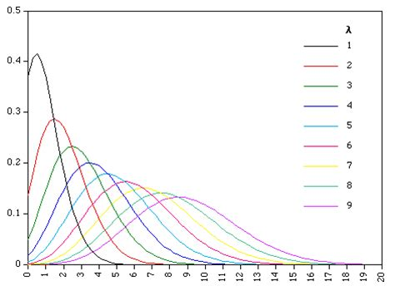
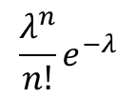
2. Poisson Random Variable Cache
# An up bound for poisson distribution
# If n is greater than this value, then the probability of getting n is truncated to 0
POISSON_UPPER_BOUND = 11
poisson_cache = dict()
def poisson(n, lam):
global poisson_cache
key = n * 10 + lam
if key not in poisson_cache.keys():
poisson_cache[key] = exp(-lam) * pow(lam, n) / factorial(n)
return poisson_cache[key]
$$\frac{λ^{n}}{n!}e^{−λ}$$

Slide 5

3. Expected Return (1/2)
def expected_return(state, action, state_value):
# initailize total return
returns = 0.0
# cost for moving cars
returns -= MOVE_CAR_COST * abs(action)
# go through all possible rental requests
for rental_request_first_loc in range(0, POISSON_UPPER_BOUND):
for rental_request_second_loc in range(0, POISSON_UPPER_BOUND):
# moving cars
num_of_cars_first_loc = int(min(state[0] - action, MAX_CARS))
num_of_cars_second_loc = int(min(state[1] + action, MAX_CARS))
# valid rental requests should be less than actual # of cars
real_rental_first_loc = min(num_of_cars_first_loc, rental_request_first_loc)
real_rental_second_loc = min(num_of_cars_second_loc, rental_request_second_loc)

Slide 6
3. Expected Return (2/2)
# get credits for renting
reward = (real_rental_first_loc + real_rental_second_loc) * RENTAL_CREDIT
num_of_cars_first_loc -= real_rental_first_loc
num_of_cars_second_loc -= real_rental_second_loc
# probability for current combination of rental requests
prob = poisson(rental_request_first_loc, RENTAL_REQUEST_FIRST_LOC) * poisson(rental_request_second_loc, RENTAL_REQUEST_SECOND_LOC)
# get returned cars, those cars can be used for renting tomorrow
returned_cars_first_loc = RETURNS_FIRST_LOC
returned_cars_second_loc = RETURNS_SECOND_LOC
num_of_cars_first_loc = min(num_of_cars_first_loc + returned_cars_first_loc, MAX_CARS)
num_of_cars_second_loc = min(num_of_cars_second_loc + returned_cars_second_loc, MAX_CARS)
returns += prob * (reward + DISCOUNT * state_value[num_of_cars_first_loc, num_of_cars_second_loc])
return returns

Slide 7
4. Policy Evaluation
while True:
new_value = np.copy(value)
for i in range(MAX_CARS + 1):
for j in range(MAX_CARS + 1):
new_value[i, j] = expected_return([i, j], policy[i, j], new_value, constant_returned_cars)
value_change = np.abs((new_value - value)).sum()
print('value change %f' % (value_change))
value = new_value
if value_change < 1e-4:
break

Slide 8

5. Policy Improvement
new_policy = np.copy(policy)
for i in range(MAX_CARS + 1):
for j in range(MAX_CARS + 1):
action_returns = []
for action in actions:
if (action >= 0 and i >= action) or (action < 0 and j >= abs(action)):
action_returns.append(expected_return([i, j], action, value, constant_returned_cars))
else:
action_returns.append(-float('inf'))
new_policy[i, j] = actions[np.argmax(action_returns)

Slide 9
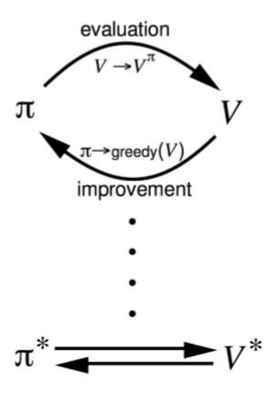
6. Value/Policy Changes
value change 45727.511447
value change 37274.506706
value change 28991.916653
value change 22532.424045
value change 17731.181203
.
.
value change 0.000233
value change 0.000190
value change 0.000155
value change 0.000126
value change 0.000103
value change 0.000084
policy changed in 318 states
value change 4644.832146
value change 801.144919
value change 629.078073
value change 534.482508
value change 437.193226
.
.
value change 0.000272
value change 0.000221
value change 0.000180
value change 0.000146
value change 0.000119
value change 0.000097
policy changed in 260 states
value change 17.749357
value change 13.007169
value change 10.449136
value change 8.010925
value change 5.874832
.
.
value change 0.000264
value change 0.000215
value change 0.000175
value change 0.000142
value change 0.000116
value change 0.000094
policy changed in 10 states
value change 0.435993
value change 0.360778
value change 0.255713
value change 0.167818
value change 0.105331
.
.
value change 0.000286
value change 0.000229
value change 0.000185
value change 0.000149
value change 0.000121
value change 0.000098
policy changed in 0 states
. . .
. . .

Slide 10
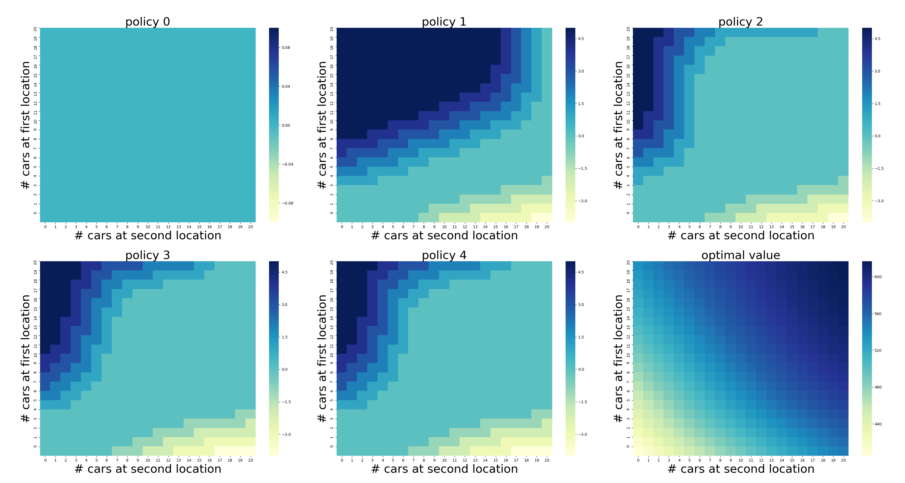
7. Policy Result

